Slide 1
Project Identification and Selection
Chapter 3

Slide 2
Project Identification
Projects are driven by business needs
  Identified by business people
  Identified by IT people
  (better yet) identified jointly by business and IT
The project sponsor believes in the system and wants to see it succeed
  Normally this is a business person
  Should have the authority to move it forward

Slide 3
Business Value
Tangible Value
  Can be quantified and measured directly
  Example: 2 percent reduction in operating costs
Intangible Value
  We know it will add value & save time, but we may not be able to quantify or measure its benefits
  Example: improved customer service

Slide 4
The Project Request
A document that describes the reasons for and the value added from building a new system
Contains 5 elements:
  Project sponsor: the primary point of contact for the project
  Business need: the reason prompting the project
  Business requirements: what the system will do
  Business value: how will the organization benefit from the project
  Special issues: Anything else that should be considered

Slide 5
Feasibility Analysis
sometimes called a feasibility study or feasibility report
is a way to evaluate whether or not a project plan could be successful
It does so by answering followin questions:
  Does our team have the required tools or resources to complete this project?
  Will there be a high enough return on investment to make the project worth ?
  Is this project feasible?
    What are the risks?
    Can these risks be overcome?
Major components:
  Technical feasibility (Can we build it?)
  Economic feasibility (Should we build it?)
  Organizational feasibility (Will they use it?)

Slide 6
Technical Feasibility
A technical feasibility study reviews the technical resources available for your project.
Determines if you have the right equipment, enough equipment, and the right technical knowledge to complete your project objectives.
For example, if your project plan proposes creating 50,000 products per month, but you can only produce 30,000 products per month in your factories, this project isn’t technically feasible.
Identify risks in the following areas:
  The functional area: Are analysts familiar with this portion of the business?
  The technology: Less familiarity generates more risk
  Project size: Large projects have more risk
  Compatibility: Difficult integration increases the risk

Slide 7
Economic Feasibility
(Cost-Benefit Analysis)
Financial feasibility describes whether or not your project is financially viable.
A financial feasibility report includes a cost-benefit analysis of the project.
It also forecasts an expected return on investment (ROI) and outlines any financial risks.
Identify the costs and the benefits
Assign values to the costs and benefits
Determine the cash flow
Determine the value using one or more methods:
  Net present value (NPV)
  Return on investment (ROI)
  Break-even point
The goal at the end of the financial feasibility study is to understand the economic benefits the project will drive.

Slide 8
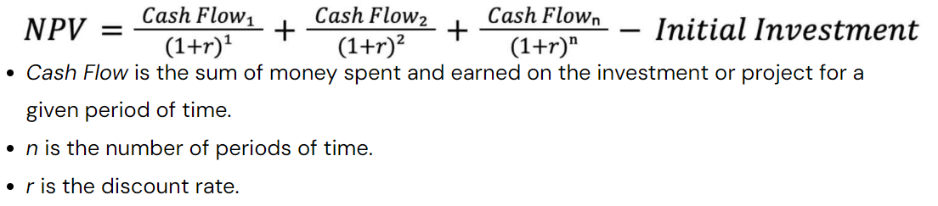
Net present value (NPV)
Net present value is used to determine whether or not an investment, project, or business will be profitable down the line.
The NPV of an investment is the sum of all future cash flows over the investment’s lifetime, discounted to the present value.
Companies often use net present value in budgeting to decide how and where to allocate capital.
NPV Formula

Slide 9
Net present value (NPV)
Return on Investment or ROI?
  Return on investment (ROI) is a ratio that measures the profitability of an investment by comparing the gain or loss to its cost.
  It helps assess the potential return of investments on things like stocks or business ventures.
  ROI is usually presented as a percentage and can be calculated using a specific formula.
  ROI Formula
    ROI = (net income / total cost of investment) x 100
    For example, if you decide to buy a Apartment for JD 400,000, for maintenance and commission you may pay up to 5% and sell it one year later for JD 450,000, calculating ROI,
      Maintenance and commission value = 450,000 X 5% = 22,500
      Net return on investment = (450,000 - 400,000) - 22,500 = 27,500
      ROI =( 27,500 / 400,000 ) X 100 = 6.875%
    NPV = (450,000 / 1.06875) - 400,000 = 21,052.631

Slide 10
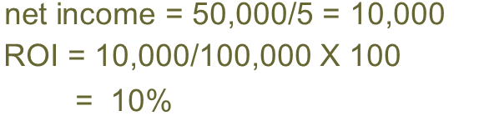
Net present value (NPV)
Return on Investment or ROI - Example
Year | Cash-flow | Accumulated
0 | -100,000 | -100,000
1 | 10,000 | -90,000
2 | 10,000 | -80,000
3 | 10,000 | -70,000
4 | 20,000 | -50,000
5 | 100,000 | 50,000

Slide 11
Net present value (NPV)
Discount factor = 1/(1+r)^{t}
  r is the interest rate (ROI) (e.g. 10% is 0.10)
  t is the number of years
In the case of 10% rate (ROI) and one year
Discount factor = 1/(1+0.10) = 0.9091
In the case of 10% rate and two years
Discount factor = 1/(1.10 x 1.10) =0.8294

Slide 12
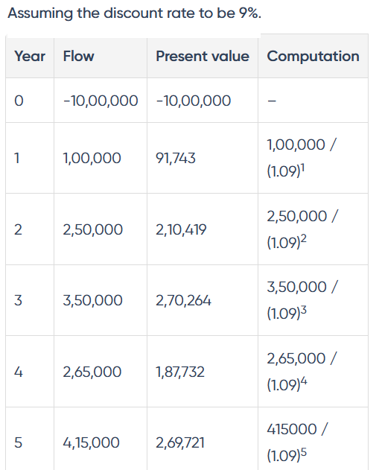
NPV

Slide 13
Net present value (NPV)
A company is considering a project requiring an initial investment of $50,000, with anticipated annual cash inflows of $20,000 for five years. What is NPV
Identify cash flows
  Initial Investment: -$50,000
  Cash Inflows (Years 1-5): $20,000 per year
Apply Discount Rate (10%) to Calculate Present Value (PV) of Cash Inflows
  Year 1 PV: $18,181
  Year 2 PV: $16,529
  Year 3 PV: $15,038
  Year 4 PV: $13,736
  Year 5 PV: $12,422
Calculate NPV
  NPV = PV of Cash Inflows - Initial Investment
  NPV = $75,906 (total PV of cash inflows) - $50,000 (initial investment)
  NPV = $25,906

Slide 14
Net present value (NPV)
Interpreting Net Present Value
  Positive NPV: A positive dollar amount means the project or investment may be profitable.
  Negative NPV: A negative dollar amount means the project or investment is unlikely to be profitable.
  Zero NPV: A net present value of zero means the project or investment is neither profitable nor costly. A company may still consider projects and investments with an NPV of zero if the project has significant intangible benefits, such as increased consumer satisfaction.

Slide 15
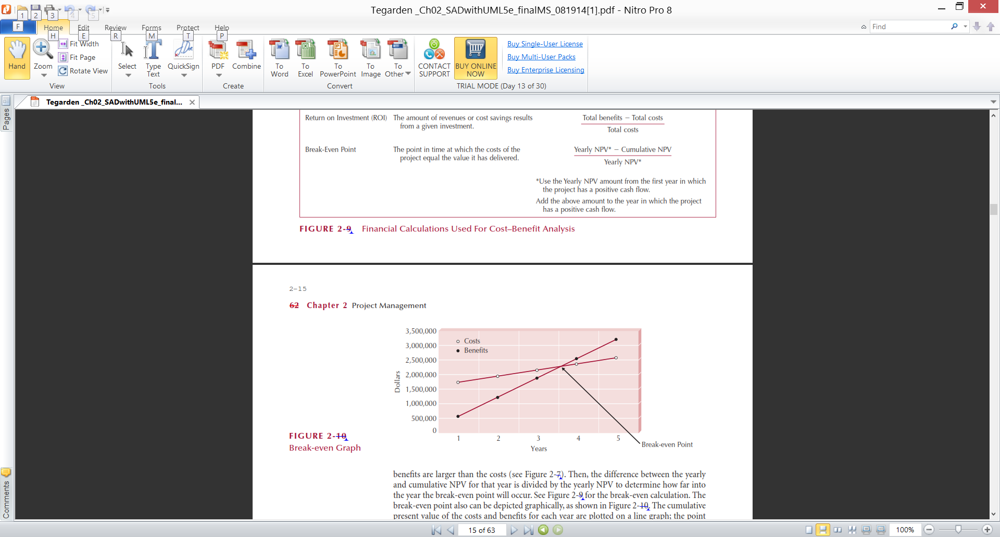
Example Break-Even Point

Slide 16
Organizational Feasibility
Will the users accept the system?
refers to the evaluation of whether a business idea is viable and compatible with the existing organizational structure, capabilities, and resources of a company.
The key aspects considered in organizational feasibility analysis include:
  Alignment with Organizational Goals:
    Assessing whether the proposed idea aligns with the overall strategic goals, mission, and vision of the organization.
    It ensures that the new idea supports the organization's core objectives and strategic direction.
  Resource Availability:
    Evaluating the availability of internal resources, including financial, human, technological, and physical resources, to support the implementation of the new idea.
    Determine if the organization has the necessary resources or if additional resources need to be acquired or allocated

Slide 17
Organizational Feasibility
The key aspects considered in organizational feasibility analysis include:
  Organizational Structure and Processes:
    Analyzing the existing organizational structure, processes, and systems to determine if they can effectively accommodate and support the proposed idea.
    Assessing whether the new idea requires significant changes to the organizational structure or if it can integrate smoothly into existing processes.
  Skills and Expertise:
    Assessing the skills and expertise of the workforce to determine if they align with the requirements of the proposed idea
    Identify any skill gaps and whether additional training needs to be considered.
  Risk Assessment:
    Identifying risks and challenges associated with implementing the new idea within the organization.
    Assessing factors such as market risks, competitive landscape, and internal operational risks.
    Understanding the risks helps the organization develop strategies and evaluate the feasibility of the idea in light of potential challenges
  By conducting an organizational feasibility analysis, companies can make informed decisions regarding the implementation of new ideas, and It helps identify any resource gaps, or strategic misalignments early on, enabling organizations to adapt and plan accordingly for successful implementation.

Slide 18
Project Selection
Screening models help managers pick winners from a pool of projects. Screening models are numeric or nonnumeric and should have:
Realism
  An effective model must reflect organizational objectives, including a firm’s strategic goals and mission.
  Criteria must also be reasonable in light of such constraints on resources as money and personnel.
  Finally, the model must take into account both commercial risks and technical risks, including performance, cost, and time
Capability
  A model should be flexible enough to respond to changes in the conditions under which projects are carried out.
    For example, the model should allow the company to compare different types of projects (long-term versus short-term projects, projects of different technologies or capabilities, projects with different commercial objectives).

Slide 19
Project Selection
Screening models help managers pick winners from a pool of projects. Screening models are numeric or nonnumeric and should have:
Flexibility
  The model should be easily modified if trial applications require changes. It must, for example, allow for changes in , tax laws, building codes, and so forth
Ease of use
  A model must be simple enough to be used by people in all areas of the organization, both those in specific project roles and those in related functional positions.
  the screening model that is applied, the choices made for project selection, and the reasons for those choices should be clear and easily understood by organizational members.
  The model should also be timely: It should generate the screening information rapidly, and people should be able to assimilate that information without any special training or skills

Slide 20
Project Selection
Screening models help managers pick winners from a pool of projects. Screening models are numeric or nonnumeric and should have:
Cost effectiveness
  The screening model should be cost effective.
  A selection approach that is expensive to use in terms of either time or money is likely to have the worst possible effect: causing organizational members to avoid using it because of the excessive cost of employing the screening model.
Comparability
  It must be broad enough to be applied to multiple projects.
  If a model is too narrowly focused, it may be useless in comparing potential projects
  A useful model must support general comparisons of project alternatives

Slide 21
Project Selection
Numeric models
  use numbers as inputs for the decision process involved in selecting projects.
Nonnumeric models,
  do not employ numbers at decision inputs, relying instead on other data

Slide 22
Screening & Selection Issues
Issues in Project Screening and Selection
  Risk—Factors that reflect elements of unpredictability to the firm, including:
    Technical risk—risks due to the development of new or untested technologies
      for example hardware and software failure, human error, spam
    Financial risk—risks from the financial caused by investing in the project
      Market risk
        involves the risk of changing conditions in the specific marketplace in which a company competes for business. One example of market risk is the increasing tendency of consumers to shop online. This aspect of market risk has presented significant challenges to traditional retail businesses.
      Credit risk is the risk businesses incur by extending credit to customers. It can also refer to the company's own credit risk with suppliers. A business takes a financial risk when it provides financing of purchases to its customers, due to the possibility that a customer may default on payment
    Safety risk
      risks to the well-being of users or developers of the project
        the risk of project failure
    Quality risk—risks to the firm’s goodwill or reputation due to the quality of the completed project
      Non-compliant to design, specifications, or regulatory requirements

Slide 23
Screening & Selection Issues
Issues in Project Screening and Selection
  Commercial—Factors that reflect the market potential of the project
    Expected return on investment
    Payback period
      is the time required to recover the initial cost of an investment. It is the number of years it would take to get back the initial investment made for a project
    Potential market share
      Market share is the percentage of total sales in an industry generated by a particular company.
      Market share is calculated by dividing the company's sales over a certain period by the industry's total sales during the same period.
      Market Share= Total Company Sales ÷ Total Industry Sales ​​
    Long-term market dominance
      Market dominance is the degree of control a company holds over a particular market or industry.
      This dominance is generally characterized by the significant market share a company enjoys about its competitors.
      Examples of Market Dominance Across Industries:
      Technology: Apple in the smartphone industry is a prime example.
      E-commerce: Amazon is another example of market dominance.

Slide 24
Screening & Selection Issues
Issues in Project Screening and Selection
  Internal operating issues—Factors that refer to the impact of the project on internal operations of the firm, including:
    Need to develop/train employees
    Change in physical environment
    Change in manufacturing or service operations resulting from the project

Slide 25
Approaches to Project Screening
Checklist model
Simplified scoring models
Financial models
3-<number>

Slide 26
Checklist Model
A checklist is a list of criteria applied to possible projects.
Requires agreement on criteriaا
Assumes all criteria are equally important
3-<number>

Slide 27
Checklist Model
depending on the type and size of our projects, we may have several important criteria.
In checklist model the project team should give emphasis on the following
  Cost of development:
    What is a reasonable cost estimate?
  Potential return on investment•
    What kind of return can we expect?
    What is the likely payback period?
  Riskiness of the new project
    Does the project need to create new-generation technology?
    How risky is the project in terms of achieving our anticipated specifications?
  Stability of the development process
    Are the project team and the parent organization both stable?
for example, the company ‘ABC’ feels that the most important selection criteria for its choice are: cost profit potential time to market development risks

Slide 28

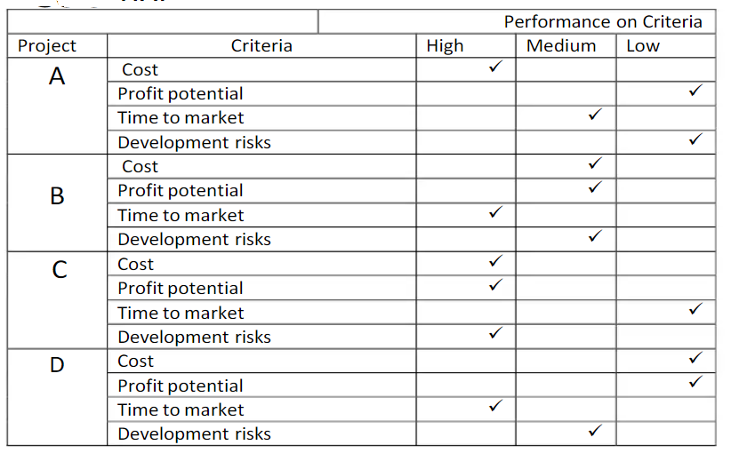

Slide 29
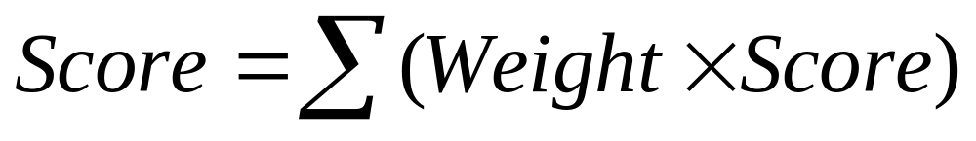
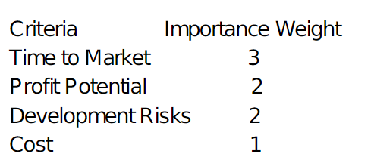
Simplified Scoring Models
Each project receives a score that is the weighted sum of its grade on a list of criteria. Scoring models require:
  agreement on criteria
  agreement on weights for criteria
  a score assigned for each criteria
Relative scores can be misleading!

Slide 30
Simplified Scoring Models
Each project receives a score that is the weighted sum of its grade on a list of criteria. Scoring models require:
  agreement on criteria
  agreement on weights for criteria
  a score assigned for each criteria
Relative scores can be misleading!
-

Slide 31

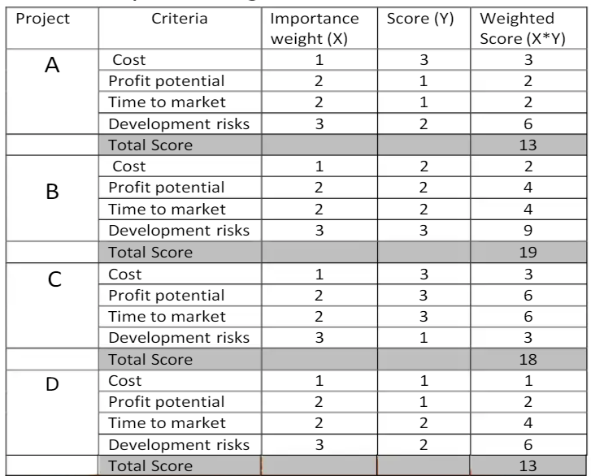

Slide 32
Financial Models
Based on the time value of money principal
Payback period
Net present value
All of these models use discounted cash flows

Slide 33
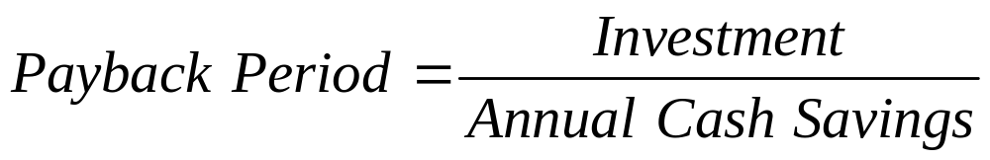
Payback Period
Determines how long it takes for a project to reach a breakeven point
The formula to calculate the payback period of an investment depends on whether the periodic cash inflows from the project are even or uneven. If the cash inflows are even the formula to calculate payback period is:
Cash flows should be discounted
Lower numbers are better (faster payback)

Slide 34
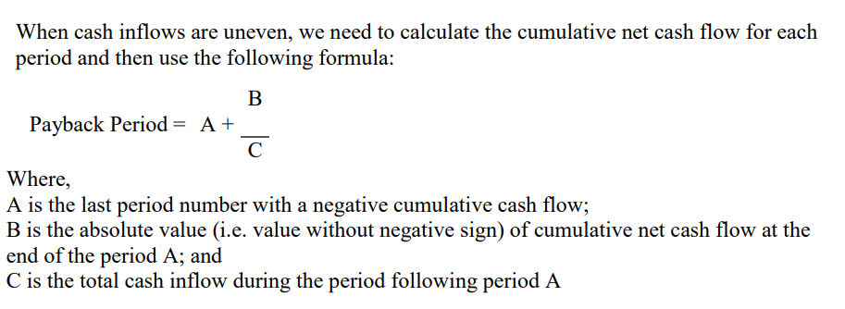

Payback Period

Slide 35
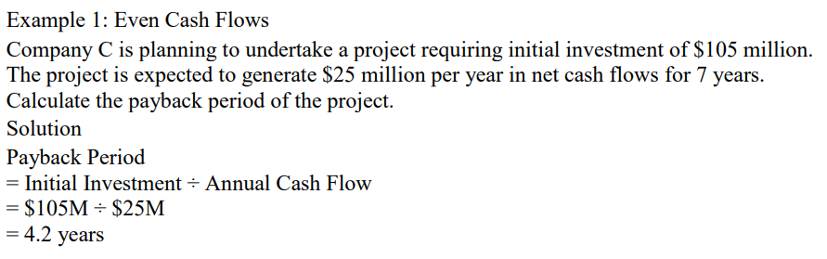
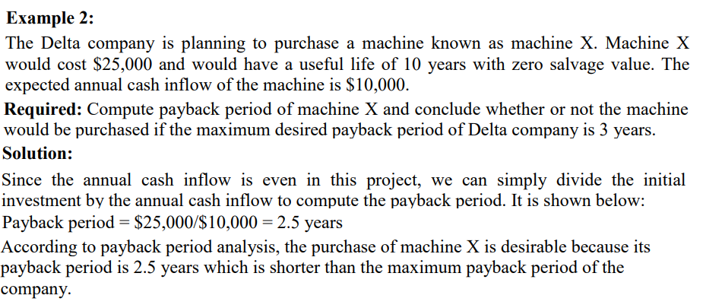
Payback Period

Slide 36
Payback Period

Slide 37
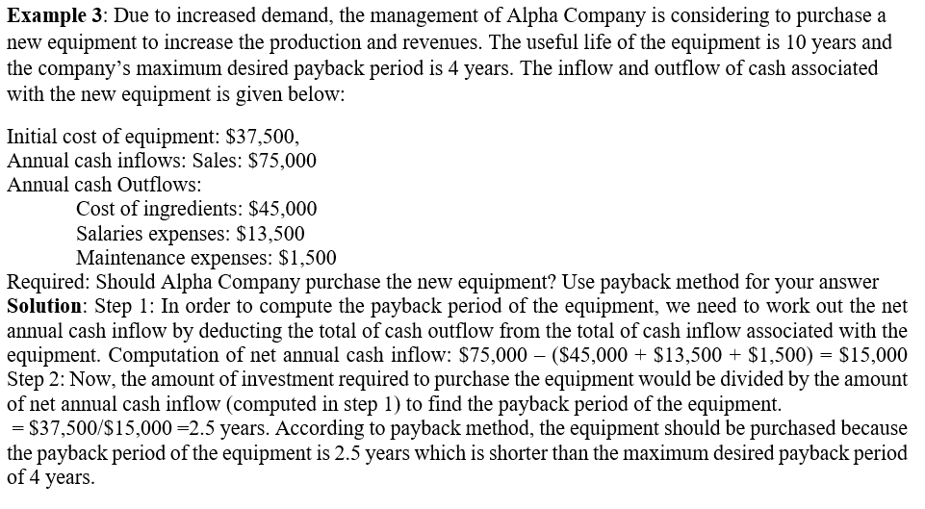
Payback Period

Slide 38
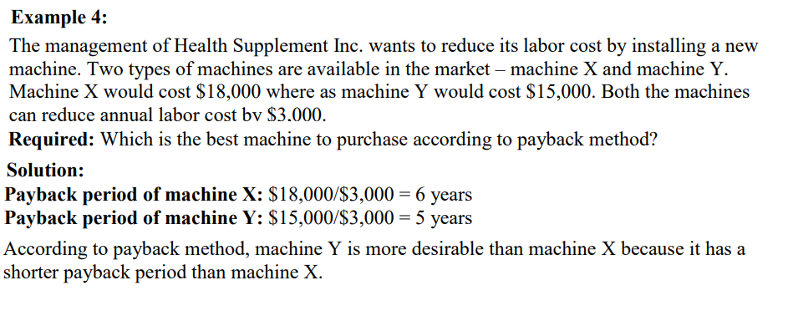
Payback Period

Slide 39
Payback Period
Payback method with uneven cash flow
  we need to compute the cumulative cash inflow and then apply the following formula:

Slide 40



Payback Period
Example 5: An investment of $200,000 is expected to generate the following cash inflows in six years:
Year 1: $70,000 Year 2: $60,000 Year 3: $55,000
Year 4: $40,000 Year 5: $30,000 Year 6: $25,000
Required: Compute payback period of the investment. Should the investment be made if management wants to recover the initial investment in 3 years or less?
Year | Cash-flow | Accumulative
0 | -200,000 | -200,000
1 | 70,000 | -130,000
2 | 60,000 | -70,000
3 | 55,000 | -15,000
4 | 40,000 | 25,000
5 | 30,000 | 55,000
6 | 25,000 | 80,000

Slide 41
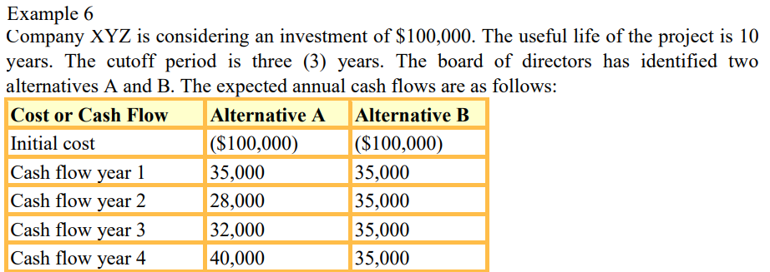
Payback Period

Slide 42
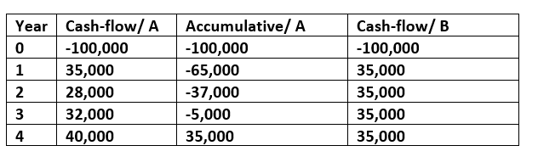
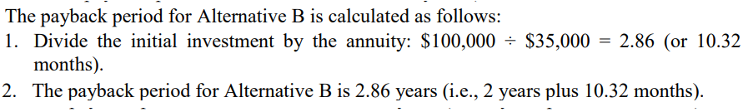
Payback Period

Slide 43
End of Presentation

